Slide 1
EARLY CINEMA

Slide 2
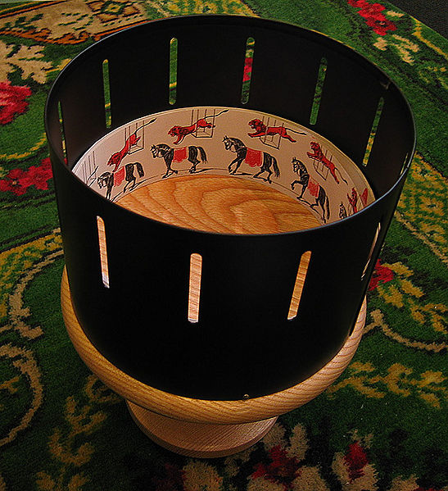
Zoetrope

Slide 3
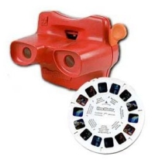
mutoscope
Pinwheel

Slide 4
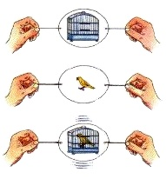
Thaumatrope

Slide 5
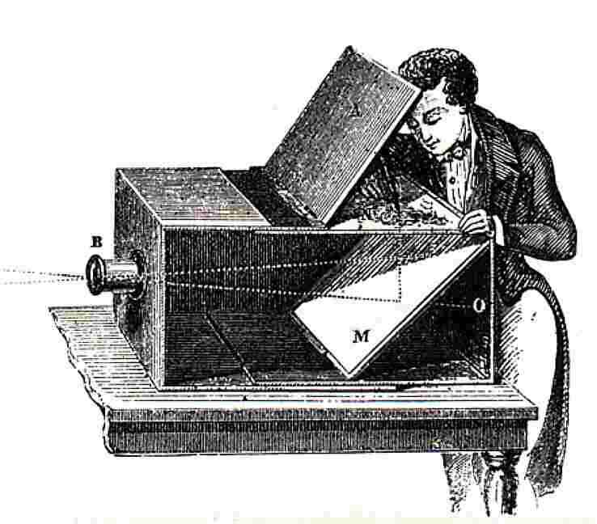
Camera obscura

Slide 6
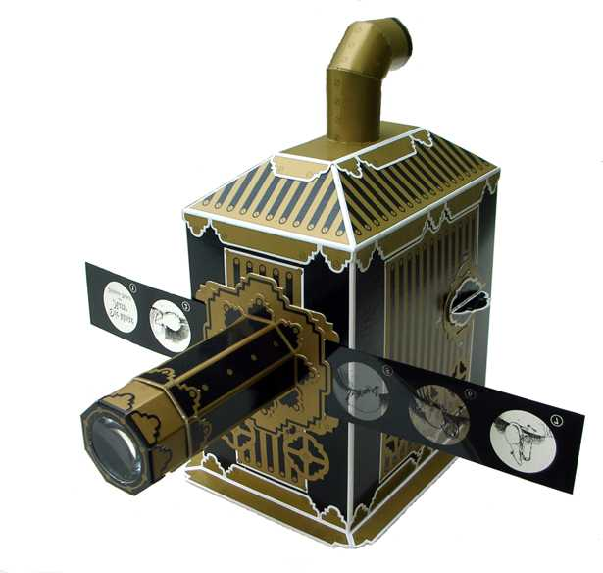
Magic Lantern

Slide 7
How does a movie MOVE?
Problem: a movie is actually a continuous series of still images
For every ONE SECOND of film, there are 24 separate still
images
So, how does it work?
Persistence of vision
Human brain holds onto an image a fraction of a second longer than the eye does

Slide 8
How does a movie MOVE?
Critical Flicker Fusion
When a light flashes fast enough and continuously enough, the illusion of a continuous beam is achieved
But, there are 48 pulses of light per second: Once a new image slides into place and once when it’s on screen, the image actually is projected twice
That’s why older films were called “flicks”→projectors, and so light continuity, were too slow, creating that flickering
SEE NEXT SLIDE

Slide 9
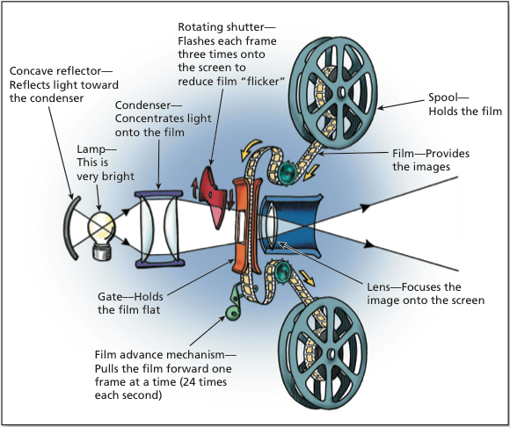

Slide 10
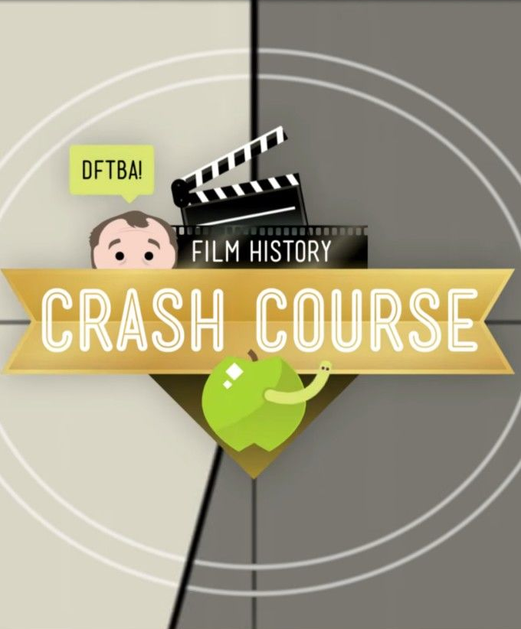
Crash Course Film History
https://www.youtube.com/watch?v=vsnB4iBb78o
Video timings to watch:
1:17-4:17
6.41 to 8:30

